Slide 1
Roots of Equations
S.J. Cheng
NCTU/EP

Slide 2
學習目標(03/30)
HW2.2 illustration (unit; strategy: 2pt formula+ bisection or newton)
Bisection method
Exercise: while()
Exercise: bi-section method + HW-review
Demo: function+while()
Newton method
Steepest decent method
Exercise: newton method + HW-review

Slide 3
Roots of an equation

Slide 4
Find the roots of an equation: bisection method

Slide 5
Find the roots of an equation: bisection method

Slide 6
Find the roots of an equation: bisection method
no
yes
C:\Users\sjche\Desktop\Work place\teaching\computational physics\roots of equations\roots eqs.py

Slide 7
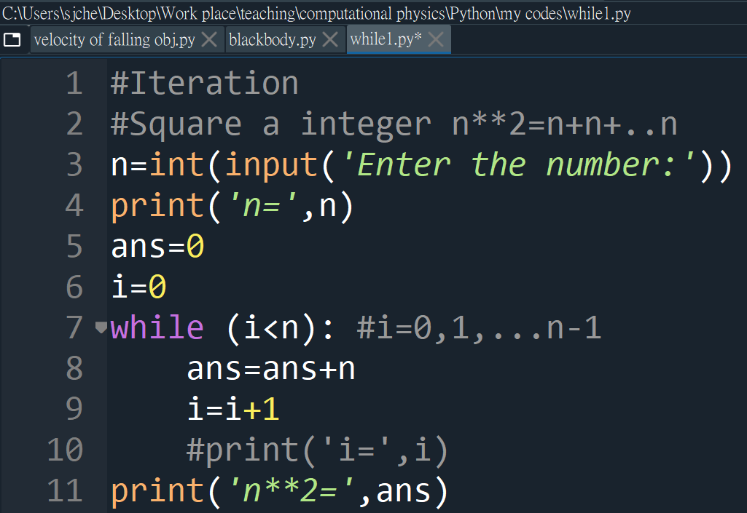
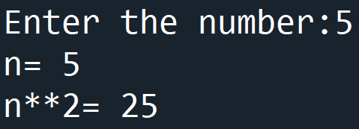
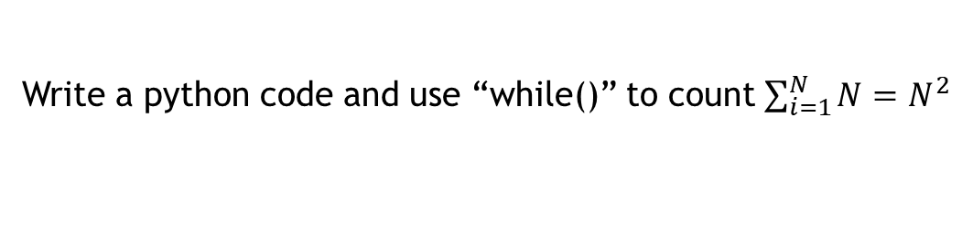
Python: while()
Write a python code and use “while()” to count $\sum_{i=1}^{N}{N}=N^{2}$
Notes:
)

Slide 8
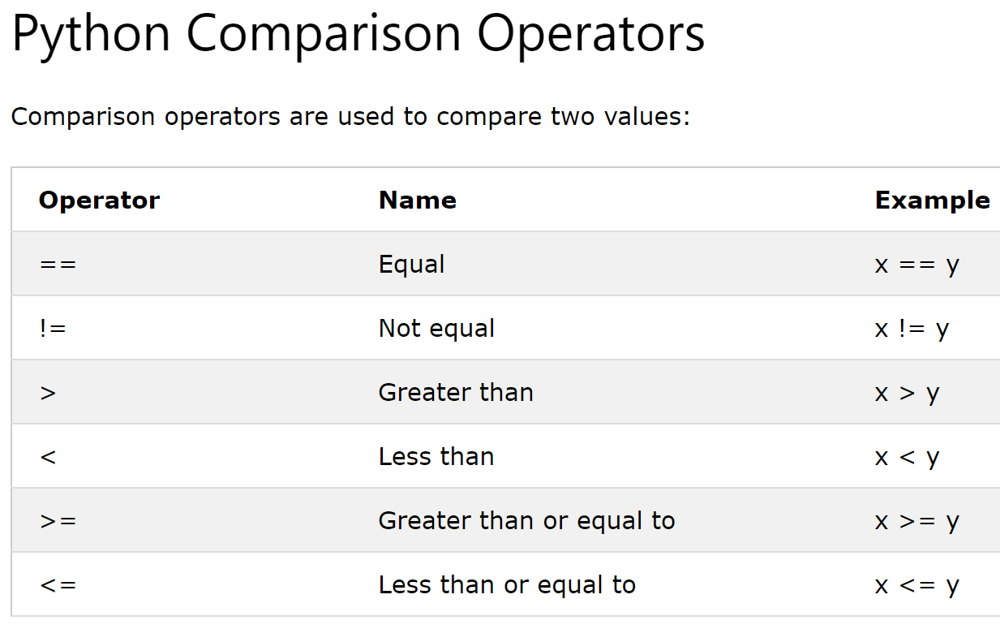
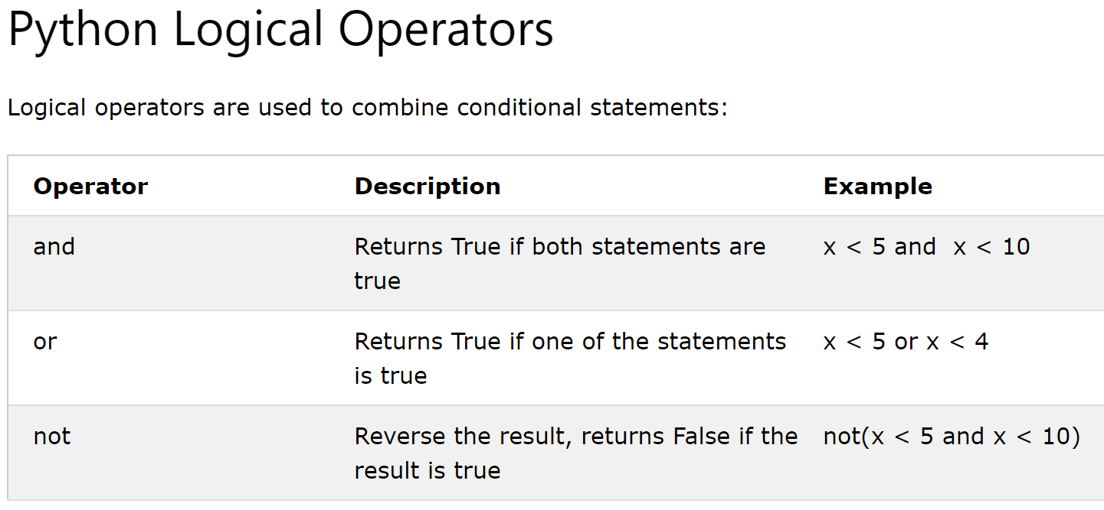
Logical operators
https://www.w3schools.com/python/python_operators.asp

Slide 9
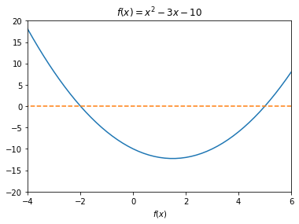
Find the roots of the equation, using the bi-section method.
exercise

Slide 10
Find the roots of an equation: bisection method
no
yes
C:\Users\sjche\Desktop\Work place\teaching\computational physics\roots of equations\roots eqs.py

Slide 11
Find the roots of an equation: Newton method

Slide 12
Roots of equation: Secant method (discrete Newton method)
If an analytical expression for the first derivative of f(x) is very difficult to obtain or even does not exist, one can replace f’ with the two-point formula.

Slide 13
Find the roots of an equation: Newton method

Slide 14
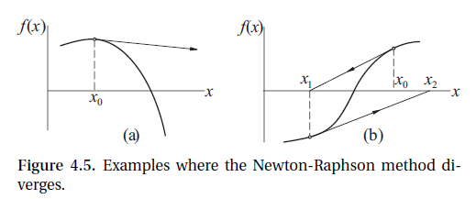
Newton method
Simple
Fast
Not always get convergent

Slide 15
Find the roots of the equation, using the Newton method.
exercise

Slide 16
Extremes of a function

Slide 17
Extremes of a function
f
f’’>0
x
g=f’
f’’>0
f’’<0
x

Slide 18
Extremes of a function with single variable:

Slide 19
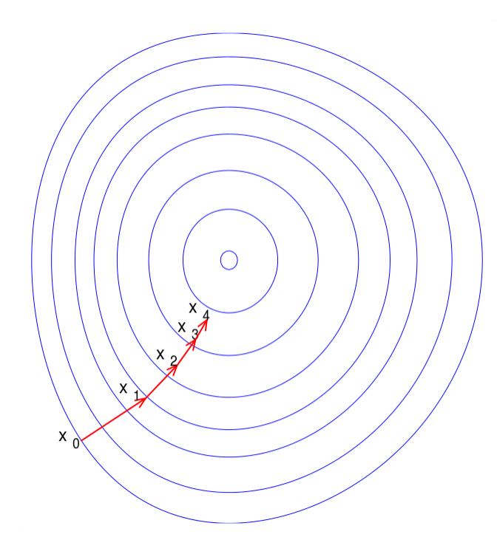
Extremes of a function with multiple variables:
p.68

